Slide 1



Cyclistic
Contact Information:
: nguyenthihoangha95@gmail.com
: kaggle.com/nguyenha95

Slide 2


Table of Contents
Objective
Data sources
Data cleaning
01
02
03
Present data
Summarization
Recommendation
04
05
06
Business task
Owner
Source
Organization
Documentation of cleaning data
Present findings
Summarize core findings
Top three recommendations for marketing plan

Slide 3
01
Objective

Slide 4
Objectives
s
How do annual members and casual riders use Cyclistic bikes differently?

Slide 5
02
Data source

Slide 6
Data source
1. Owner:
The data has been made available by Motivate International Inc. under this license
2. Source:
Data for this case study has been obtained from company’s records and was stored here
3. Organization:
- The data used for this case includes records in 12 months: from Dec 2021 to Nov 2022
-The data includes records of each registered trip: started and ended time; name, id and coordinates of stations; type of bike; type of customer: member or casual
- Dataset includes 5,662,667 registered trip

Slide 7
03
Data cleaning

Slide 8


Data cleaning
1
2
3
4
Wrong data type
Missing value
Wrong data
Add columns
In some file, columns [start_station_id] and [end_station_id] are automatically set object datatype with under 8 characters. I expand to 50 characters so I can merge files into one
There are missing values of station’s name and id
I updated stations ids by grouping station name and ids already existed and filled missing ids by name of stations: 500,531 cases
Delete 70,748 cases which have started time after ended time.
Finally, I got 5,662,667 to process analyze
Add more columns to analyze:
[ride_length]
[month]
[day_of_week]
[at_hout]
[ride_length_days]
[ride_length_hours]
[ride_length_minutes]

Slide 9
04
Present data

Slide 10
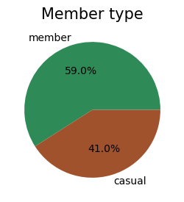
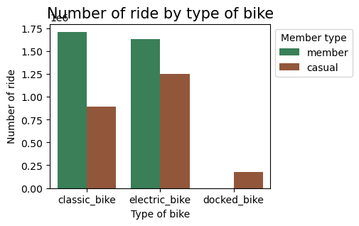
Overview
Cyclistic users completed over 5,6 million trips in 2022
Cyclistic has two classification for its users:
- Customers who purchase single-ride or full-day passes are referred to as Casual Riders
- Customers who purchase annual membership are referred to as Members
52,5% number of trip in which customer choose electric bike
While member likes both classic and electric bike when they riding, casual customer prefers to use electric bike

Slide 11
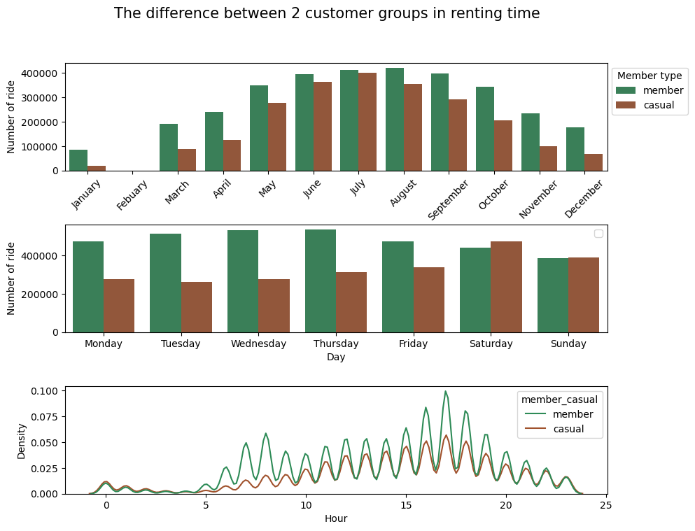
Monthly ride
Summer
Most customer prefers to ride bicycle in the summer
Member usually rent bike in day of week while casual customer prefers to ride bike in weekend
In general, most of member uses service in rush hour.
Especially number of member is significantly more than casual member in 2 points time: 8AM and 5PM
5PM
8AM
Morning rush hour
Afternoon rush hour

Slide 12

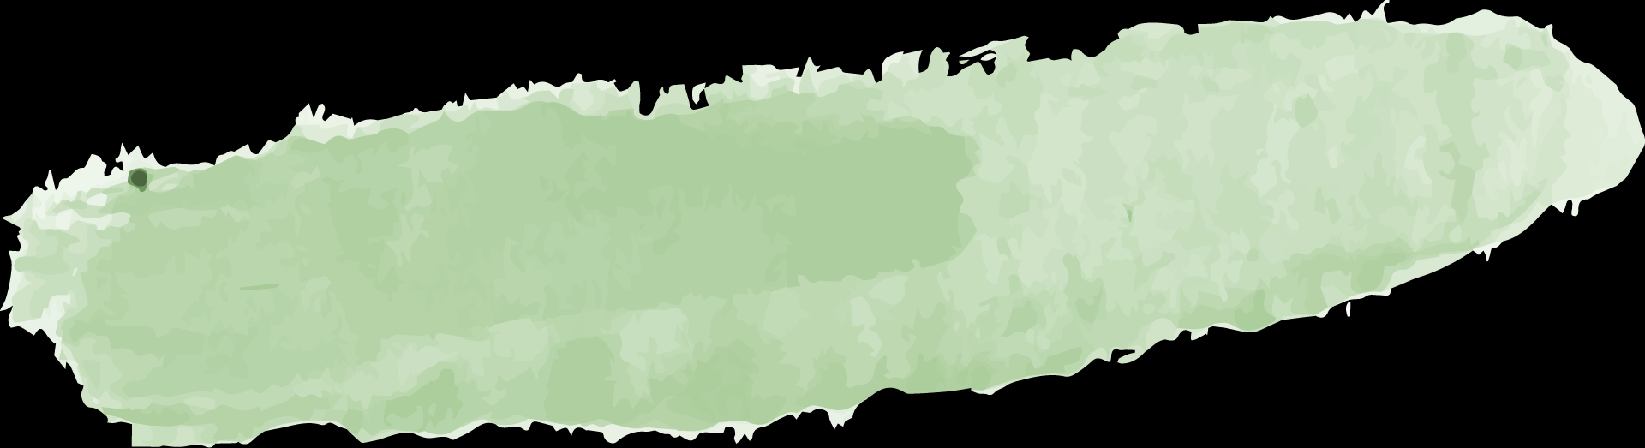

96%
3%
1%
Separate to 3 groups
I decide to divide into 3 groups of ride’s length to find if any different behavior between 2 types of customer
Group 1
Group 2
Group 3
Length or ride lasted under 1 hour
length of ride lasted from 1 hour to under 1 day
length of ride lasted from 1 day and more

Slide 13
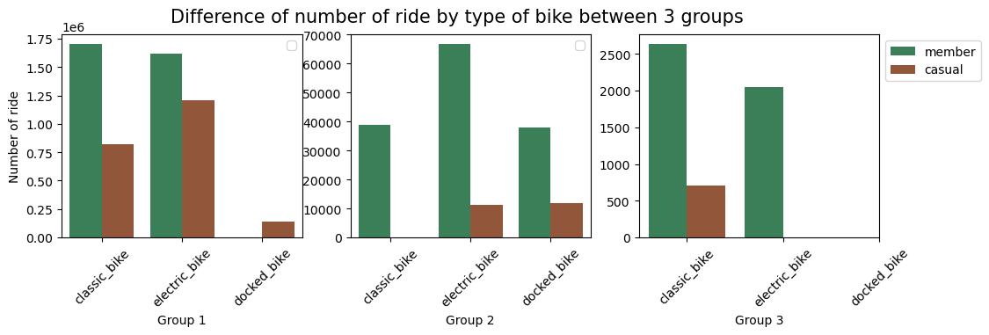
Overview
In group 1, classic bike and electric bike are almost equal popularity in member group, while casual customer prefers to ride electric bike a little bit
In group 2, member group prefers to choose electric bike for their trip
In long trip – group 3 - classic bike seems to be more popular
Note:
* Group 1: length or ride lasted under 1 hour
* Group 2: length of ride lasted from 1 hour to under 1 day
* Group 3: length of ride lasted from 1 day and more

Slide 14
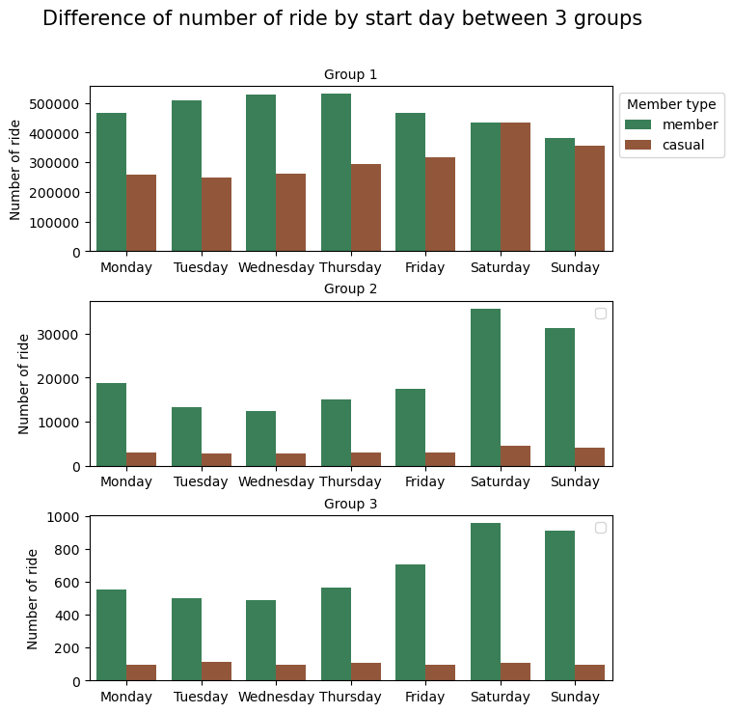
Difference in start day between groups
Most of member has trend in renting bike for short trip in weekday, and long trip in weekend
It seems that casual customer does not like to ride bike with a long trip (over 1 hour)
Note:
* Group 1: length or ride lasted under 1 hour
* Group 2: length of ride lasted from 1 hour to under 1 day
* Group 3: length of ride lasted from 1 day and more

Slide 15
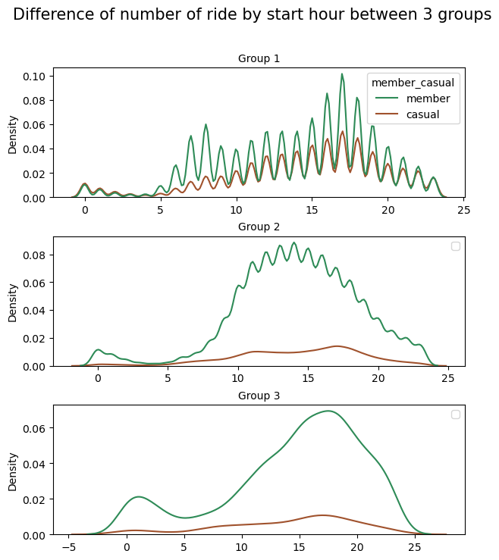
Difference in start time between groups
In group 1, member starts to ride in rush hour, casual customer seems not like ride a bike in the morning
In group 2, member starts to ride after breakfast and before dinner time (9AM to 6PM)
In group 3, member starts to rent bike reached the highest point at 5PM
Note:
* Group 1: length or ride lasted under 1 hour
* Group 2: length of ride lasted from 1 hour to under 1 day
* Group 3: length of ride lasted from 1 day and more
Morning rush hour
Afternoon rush hour

Slide 16
96%
Due to large dataset, I will focus on group 1 in next steps
Group 1
Length or ride lasted under 1 hour

Slide 17
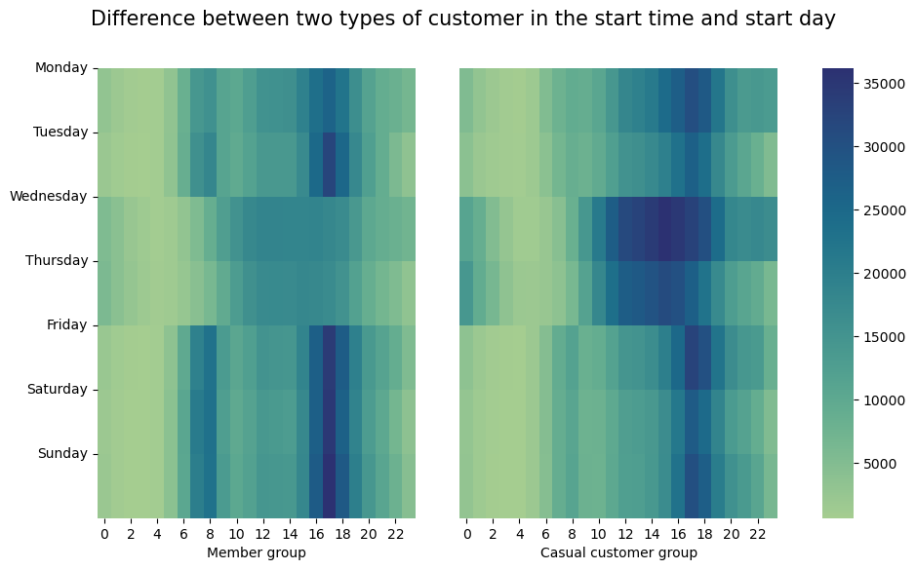
Difference between two types of customer in start day and start time
Member and casual usually rent bike in rush hour from Monday to Sunday.
But in Wednesday and Thursday there are differences between 2 groups:
Fewer member rents bike in these days
More casual customer rents bike right after lunch
Morning rush hour
Afternoon rush hour

Slide 18
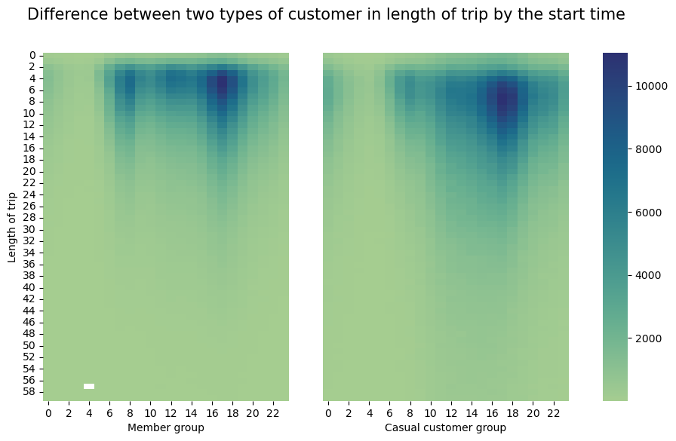
Difference between two types of customer in length of trip and start time
Member usually start soon with shorter time of trip since they usually use bike to commute to work
Casual customer starts later but they ride longer than member group, and they rent bike in afternoon rush hour time more than in the morning
Average length of ride by member is 11.2 minutes
Average length of ride by casual customer is 15.5 minutes

Slide 19
05
Summarization

Slide 20
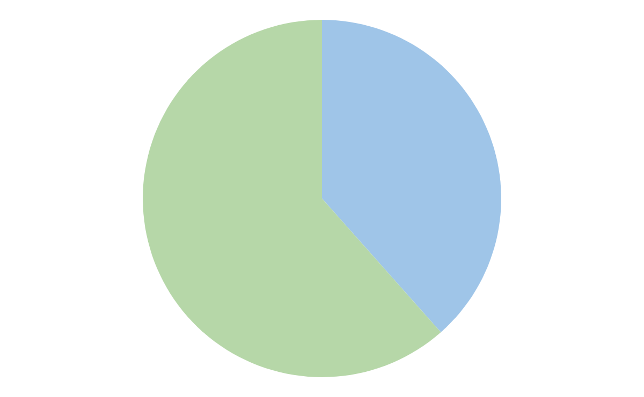
Customer
Member
Casual
Likes both classic and electric bike
Rents bike in weekday more than weekend
Rents bike both in on-shift and off-shift time
Has long trips (over 1 hour)
Starts sooner with shorter trips, average time is 11.2 minutes
Less trips in Wednesday and Thursday
Prefers electric bike
Rents bike in weekend more than weekday
Rents bike more in off-shift time
Does not like to ride bike in long trip (over 1 hour)
Starts later with longer trips, average time is 15.5 minutes
More trips in Wednesday and Thursday
41%
59%

Slide 21
06
Recommendation

Slide 22
Discount
Marketing campaign
Competition
Top 3 recommendations
Due to casual customer rides bike with longer time, we can emphasis that they can save a large amount of money when they are member
Run marketing campaign in summer
For member, display level is higher in day of week
For casual customer, display level is higher in weekend
Reward for customer who ride a significant distance: mini gift, voucher,…could extract more casual member to join in and convert to member

Slide 23
THANKS
Do you have any questions?
addyouremail@freepik.com
+91 620 421 838
yourcompany.com
Please keep this slide for attribution

